Slide 1
Measuring Public Procurement
The Case of Chile
December, 2016

Slide 2
Measuring The System

Slide 3
Experience From Chile
Public Procurement in Chile has been measured in several ways.
Possibly the most important being the following ones :
OECD / DAC (2006 version) (2008) with IDB
Program Evaluation: Market Failure Approach (2014) by Finance Ministry
Pilot Country to Test the MAPS New Release (forthcoming in 2017)
Performance Indicators (Periodical)
Each one respond to a different scope:
The system (1-3)
The procurement itself (4)
The following slides explain and comments each one.

Slide 4
I. OECD / DAC RESULTS:
Broad Institutional View of the System

Slide 5
OECD / DAC RESULTS:
Broad Institutional View
of the System
We have an assessment of the system in 2007-2008 using the OECD / DAC methodology.
The methodology used was a broad assessment of the institutions of Public Procurement at a Country level.
The assessment itself allowed to engage in field of public procurement several of the main stakeholders:
Ministry of finance Institution in charge of the normative/regulatory function for public procurement
MOP, MINVU, CENABAST
Tribunal de Contratación Pública
Dirección de presupuestos
Contraloría General de la República, Consejo de Auditoría Interna General de Gobierno
Anti-corruption agencies (Transparencia Internacional)
Servicio Civil
Representatives of private sector
Representatives of civil society
Universities
Media

Slide 6
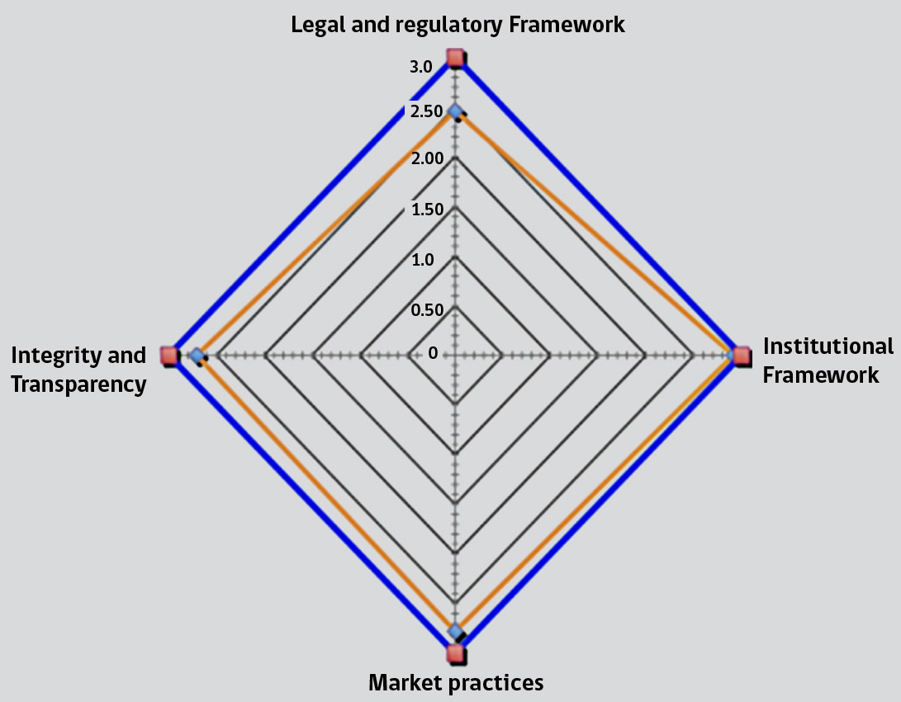
OECD / DAC RESULTS:
Broad Institutional View
of the System
Results were near the optimum, specially in institutional framework.
The dimension with the most prominent GAP was Legal and Regulatory, were the mission which assessed the system note the dissimilarity of norms between goods and services, and public works.
Dimension | Observed level
Legal and regulatory Framework | 2.5
Institutional Framework | 2.9
Market practices | 2.8
Integrity and Transparency | 2.7

Slide 7
OECD / DAC RESULTS:
Broad Institutional View
of the System
Some thoughts in regard to the methodology:
The Methodology consisted in a deep institutional understanding of the National System, but was not appropriate to engage in reform all the relevant parties:
Results were fundamental in order to keep the track to lever the competition, the openness of the system and the idea of achieving “full transparency”.
Nevertheless that track (increases in: competition, openness and transparency) was already decided before the assessment!
The application of the methodology (unlike the MAPS under current consultation) didn’t account for the origin of the assessment (e.g., a donor requirement OR due to the country's need to implement reforms):
Hence, several recommendations didn’t find the optimum “soil” to cause the required reform

Slide 8
II. Impact Program Evaluation
By Ministry of Finance

Slide 9
Impact Program Evaluation:
By Ministry of Finance
The aim was to determine if ChileCompra's mission and strategic objectives are conducive to reducing market failures.
The following are the most relevant market failures in the field of public procurement. Transaction Costs:
1. Search costs: the time and all costs associated with a buyer matching a seller. In underdeveloped industries, these costs can become an important component of the total cost of the good or service, especially considering that Chile is a country of more than 4,300 kilometers in length.
2. Negotiation costs: Negotiations are expensive because they may involve long periods of price haggling, questions of the state of the good or quality of service, incentives to conceal information, disagreements, the exercise of a dominant position, etc.
3. Implementation costs: in this case, it can be associated with the cost of each state's distribution in the implementation of a platform or a procurement system (not necessarily electronic). When these costs are very high, some transactions may stop happening. ChileCompra generates efficiencies both through economies of scale and through the reduction of duplication of activities.

Slide 10
Impact Program Evaluation:
Asymmetries of information:
1. Adverse selection: The supplier (or buyer) of a good or service is not able to distinguish between different types of buyers (or suppliers), generating a poor balance. As an example, if a provider offers life insurance, but is unable to distinguish the level of risk aversion of its potential customers, a possible result is that life insurance is offered at an average price, subsidizing more risky persons in detriment of the most cautious.
2. Moral hazard: Given the contracting of the good or service, the incentives of the supplier or buyer change, creating a poor balance. As an example, people tend to be more careless when they have purchased auto insurance.

Slide 11
Impact Program Evaluation:
Externalities:
1. Transparency: Transparency limits "bad practices" in the supply chain since any vicious act could be detected, denounced and eventually sanctioned. "Non-transparency", on the other hand, generates that the good or service is not acquired from a supplier with the lowest marginal cost. That situation generates a transaction in detriment of the State as a whole. In this context, "non-transparency" will be considered as an externality since the person who generates the benefit does not pay the social cost (buy at a marginal cost that is not the lowest).
2. Incentives to sustainability: Incentives to sustainability bring the private marginal cost to the marginal social cost, partially solving the coordination problem, since no supplier has incentives alone to offer products or services with sustainable criteria. Hiring services or purchasing goods that are produced sustainably have a benefit for the State, since they do incorporate the cost of negative externalities (or do not incorporate the benefit of the positive externalities) produced by the purchases of the organisms alone.

Slide 12
Impact Program Evaluation:
What is measured here is the causality of the strategic products of Chilecompra (Observatory, Public Procurement Electronic System, Framework Agreements, Services to Users).
If the strategic product is causally connected with the market failure (and with the institutional objectives), then the quantitative assessment in specific aspects is performed.

Slide 13
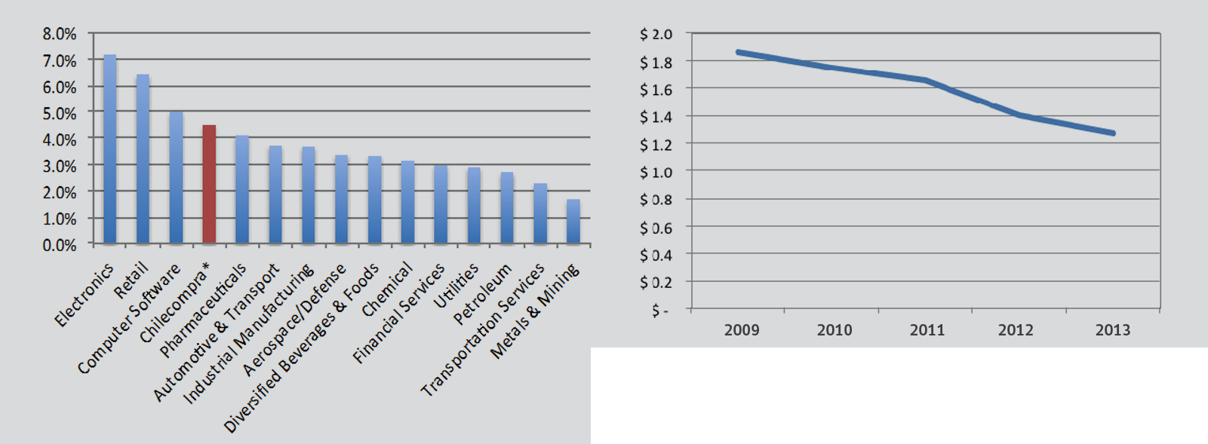
Impact Program Evaluation:
The results were (very) positive, both in terms of causality and performance of each strategic product. Some interesting results:
Benchmark of savings with several industries:
Evolution of Average Cost per Purchase Order of Framework Agreements:

Slide 14
III. Chile:
Measuring Public Procurement:
Performance Indicators

Slide 15
Performance Indicators from Chile
The following are the indicators used to assess the performance of the procurement:
Competition / efficiency
Percentage of tenders with 3 or more bids
Average bids per tender
Percentage of savings (considers only prices)
Percentage of savings in Framework Agreements (considers only prices)
Number of suppliers doing business in the system
Amount of savings by centralization of purchases via Framework Agreements
Transparency
Percentage of coverage of the Public Procurement Observatory
Number of detections (by red flags)
Percentage of contracts fully managed on-line
Transparency Index (with UNDP)
Secondary objectives
Percentage of purchases (all mechanisms) which includes sustainable criteria
Percentage of tenders which includes sustainable criteria
Market share (in terms of value) of MSE
Satisfaction
Percentage of public officers who claim to be satisfied with the performance of the system
Percentage of suppliers who claim to be satisfied with the performance of the system
Several measures of customer satisfaction in specific areas (v. gr., training of public officials and suppliers)
Corruption perception index of the public procurement system (stakeholders and users)
Efficacy
Uptime of the electronic system
Availability of Services (can the
Comments:
The main difficulties with this kind of indicators are:
i.- to avoid the idea of an optimum and
ii.- to boost the logic of strategic management
Specially when they are used to assess performance of specific organizations.
Continuous performance evaluation

Slide 16
IV. Chile:
Pilot Country to Test the New MAPS

Slide 17
Chile: Pilot
Why are we excited to do this evaluation?
1. First of all, because a long time has passed since the last comprehensive (systemic) evaluation
2. Is the opportunity to re-engage in the issue of public procurement the relevant stakeholders
3. Allows to contrast diagnoses that have been configured since the last full-evaluation
4. The methodology has been considerably improved in terms of scope and addresses primary and secondary objectives in a balanced way
5. Allow us to update our beliefs about how national systems should be in terms of:
Public works
State owned enterprises
Public Procurement Public Policy
The role of CPBs in the system

Slide 18
Chile: Pilot
What are we expecting from the Pilot?
To contribute to the development of the methodology
Involve in a long term relationship relevant high-level actors
Identification of relevant GAPS and a way to face them
Customization of recommendations based on our national characteristics and institutional context (the new MAPS has a relevant section devoted to this aspect)
That is to say, many things that can be summarized in “customized advice regarding the results”.

Slide 19
Measuring Public Procurement
The Case of Chile
December, 2016

